Slide 1
Segmentation Update
Benjamin Green 07/10/2020

Slide 2
Discussion points
Preliminary data which is showing some correlations
Next steps for quantification

Slide 3
Overall assessment
Overall algorithm assessment
Reviewer | # of cells accepted as IF (fraction) | total IF cells reviewed | # of cells accepted as SP (fraction) | total SP cells reviewed
1 | 2614 (.17) | 15011 | 1687 (.12) | 14657
2 | 2920 (.19) | 15011 | 2445 (.17) | 14657
3 | 2727 (.18) | 15011 | 6071 (.41) | 14657
4 | 3425 (.23) | 15011 | 2596 (.18) | 14657
5 | 2356 (.22) | 10714 | 2265 (.22) | 10343
Note: Values taken as the totals from 5 images for reviewers 1-4 and 4 images for reviewer 5

Slide 4
Paired Comparison
Paired comparison
Reviewer | # of pairs accepted as IF (fraction) | # of pairs accepted as SP (fraction) | # of pairs accepted as Both (fraction) | # of pairs as neither (fraction) | # of pairs as artifact (fraction) | total number of pairs reviewed | total number of pairs found | unique IF cells | unique SP cells
1 | 2480 (.26) | 1691 (.18) | 4302 (.45) | 1191 (.12) | 12 (~0) | 9562 | 14896 | 14598 | 13625
2 | 2799 (.25) | 2466 (.22) | 5440 (.48) | 565 (.05) | 2 (~0) | 11248 | 14896 | 14598 | 13625
3 | 2621 (.19) | 6204 (.46) | 1545 (.11) | 3279 (.24) | 9 (~0) | 13608 | 14896 | 14598 | 13625
4 | 3270 (.28) | 2572 (.22) | 4729 (.40) | 1302 (.11) | 0 (0) | 11754 | 14896 | 14598 | 13625
5 | 2190 (.25) | 2254 (.26) | 3531 (.40) | 781 (.09) | 1 (~0) | 8728 | 10514 | 10403 | 9712
Note: Fractional values are taken as the category / total number of pairs reviewed; values taken as the totals from 5 images for reviewers 1-4 and 4 images for reviewer 5

Slide 5
Non-paired comparison & Drawn cells
Non-paired comparison
Reviewer | IF non paired accepted (fraction) | IF non paired cells | SP non-paired accepted (fraction) | SP non-paired cells
1 | 225 (.54) | 413 | 672 (.65) | 1032
2 | 258 (.62) | 413 | 901 (.87) | 1032
3 | 199 (.48) | 413 | 890 (.86) | 1032
4 | 272 (.66) | 413 | 946 (.91) | 1032
5 | 216 (.69) | 311 | 590 (.94) | 631
Drawing comparison
Reviewer | drawn cells | added cells
1 | 2142 | 1713
2 | 965 | 459
3 | 4704 | 1963
4 | 3281 | 3274
5 | 1178 | 741

Slide 6
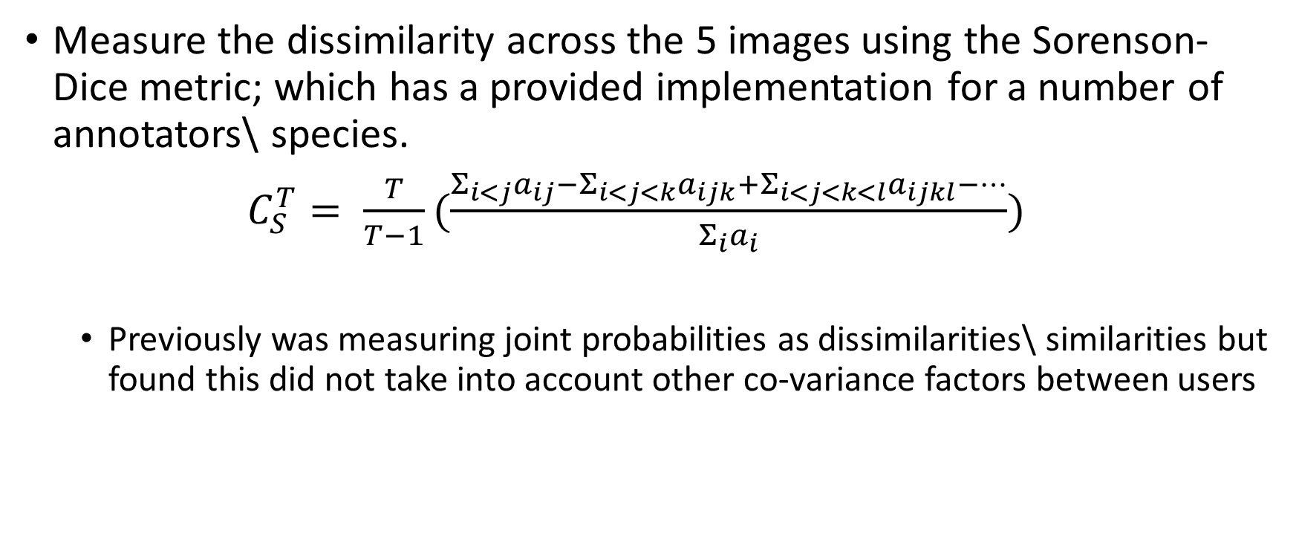
Next steps for quantification
Measure the dissimilarity across the 5 images using the Sorenson-Dice metric; which has a provided implementation for a number of annotators\ species.
$C_{S}^{T}= \frac{T}{T−1}(\frac{Σ_{i<j}a_{ij}−Σ_{i<j<k}a_{ijk}+Σ_{i<j<k<l}a_{ijkl}−…}{Σ_{i}a_{i}})$
Previously was measuring joint probabilities as dissimilarities\ similarities but found this did not take into account other co-variance factors between users

Slide 7
Need to determine how many users to annotate each image
Determine the ideal consolidation for each image using information from 2, 3, 4, and 5 users separately
Measure the dissimilarity of each user to the ideal consolidation image
Plot user dissimilarity vs. n user models for each image
Compute total dissimilarity for all users to the ideal consolidation image
Plot image dissimilarity vs. n user models

Slide 8
Need to determine how many users to annotate each image
Ideal consolidation can be found by:
Estimating most similar annotations using Jaccard index (or similar), selecting the mode between workers (assessing ties by median or randomly) – similar to a majority voting
Estimating most similar annotations using Jaccard index (or similar), averaging across samples – Jaccard index is the intersection over the union between user outputs
Expectation Maximization – estimates weighted parameters for each users (or scores each users) based on their similarity scores to other users

Slide 9
Need to determine how many users to annotate each image
For determining the ideal consolidation for each image using information from 2, 3, and 4 users there are multiple variations to choose from (user A-B, B-C, C-D). We can either;
Do all combinations and take an average measure at the end
Use resample methods n number of times to grow the sample size

